Slide 1

Lecture #5
Digital Image Processing
Image Enhancement
1st Semester
2019-2020
Dr. Abdulhussein Mohsin Abdullah
Computer Science Dept., CS & IT College, Basrah Univ.

Slide 2
Background
Filter term in “Digital image processing” is referred to the subimage.
There are others term to call subimage such as mask, kernel, template, or window.
The value in a filter subimage are referred as coefficients, rather than pixels.

Slide 3
Basics of Spatial Filtering
The concept of filtering has its roots in the use of the Fourier transform for signal processing in the so-called frequency domain.
Spatial filtering term is the filtering operations that are performed directly on the pixels of an image.

Slide 4
Mechanics of spatial filtering
The process consists simply of moving the filter mask from point to point in an image.
Spatial masks are used and convolved over the entire image for local enhancement (spatial filtering)

Slide 5

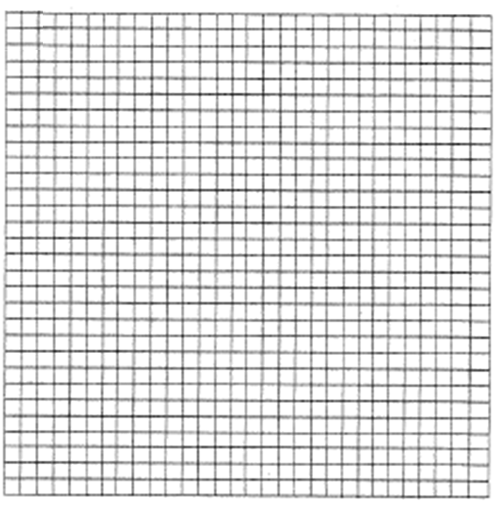
Input Image
Mask

Slide 6
Input Image

Slide 7
Input Image

Slide 8
Input Image

Slide 9
Input Image

Slide 10
Input Image

Slide 11
At each point (x, y) the response of the filter at that point is calculated using a predefined relationship.
The output intensity value at (x,y) depends not only on the input intensity value at (x,y) but also on the specified number of neighboring intensity values around (x,y)
The size of the masks determines the number of neighboring pixels which influence the output value at (x,y)
The values (coefficients) of the mask determine the nature and properties of enhancing technique

Slide 12
The mechanics of spatial filtering
For an image of size M x N and a mask of size m x n
The resulting output gray level for any coordinates x and y is given by
Mask
Mask Coefficients
w(-1,-1)
w(-1,0)
w(-1,1)
w(0,-1)
w(0, 0)
w(0,1)
w(1,-1)
w(1,0)
w(1,1)
f(x-1,y-1)
f(x-1,y)
f(x-1,y+1)
f(x,y-1)
f(x,y)
f(x,y+1)
Pixels of image section under mask
f(x-1,y+1)
f(x+1,y)
f(x+1,y+1)

Slide 13
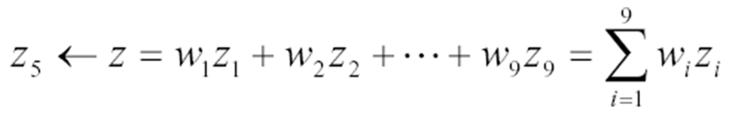
Given the 3×3 mask with coefficients: w₁, w₂,…, w₉
The mask cover the pixels with gray levels: z₁, z₂,…, z₉
Z1
Z2
Z3
w1
w2
w3
Z4
Z5
Z6
w4
w5
w6
Z7
Z8
Z9
w7
w8
w9
Subimage
Mask Coefficients
z gives the output intensity value for the processed image (to be stored in a new array) at the location of z₅ in the input image

Slide 14
Mask operation near the image border
Problem arises when part of the mask is located outside the image plane; to handle the problem:
Discard the problem pixels (e.g. 512x512_{input} 510x510_{output} if mask size is 3x3)
Zero padding: expand the input image by padding zeros (512x512_{input} 514x514_{output})
  Zero padding is not good create artificial lines or edges on the border;
We normally use the gray levels of border pixels to fill up the expanded region (for 3x3 mask). For larger masks a border region equal to half of the mask size is mirrored on the expanded region.

Slide 15
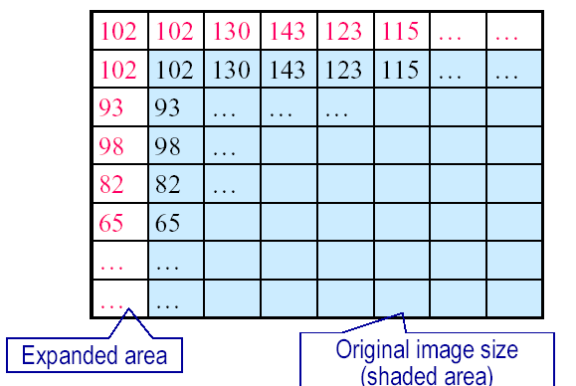
Mask operation near the image border

Slide 16
Correlation vs. Convolution
The output of correlation is a weighted sum of input pixels.
Need to
define mask
weights!
output image

Slide 17
Correlation (linear operator)
Correlation:
  Move the filter mask to a location
  Compute the sum of products
3. Go to 1.
a b
w(x, y) O f(x, y) =
Σ Σ
w(i, j)
f(x + i, y + j)
i a j b

Slide 18
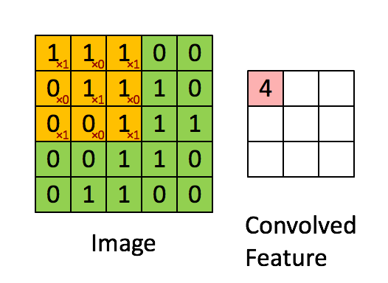

Slide 19
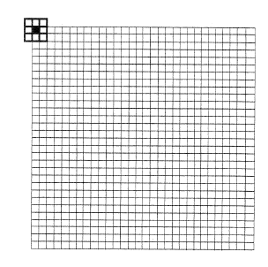
Handling Pixels Close to Boundaries
pad with zeroes
0 0 0 ………………………………….0……..0
0 0 0 ……………………….0………………0

Slide 20
Often used in applications where we need to measure the similarity between images or parts of images (e.g., template matching).

Slide 21
Convolution (linear operator)
Similar to correlation except that the mask is first flipped both horizontally and vertically.
If w(i, j) is symmetric (i.e., w(i, j)=w(-i,-j)), then convolution is equivalent to correlation!

Slide 22
Convolution:
  Rotate the filter mask by 180 degrees
  Correlation
a b
Σ Σ
w(x, y) ⇥ f(
x, y) =
w(i, j)
f(x- i, y - j)
i=-a j=-b

Slide 23
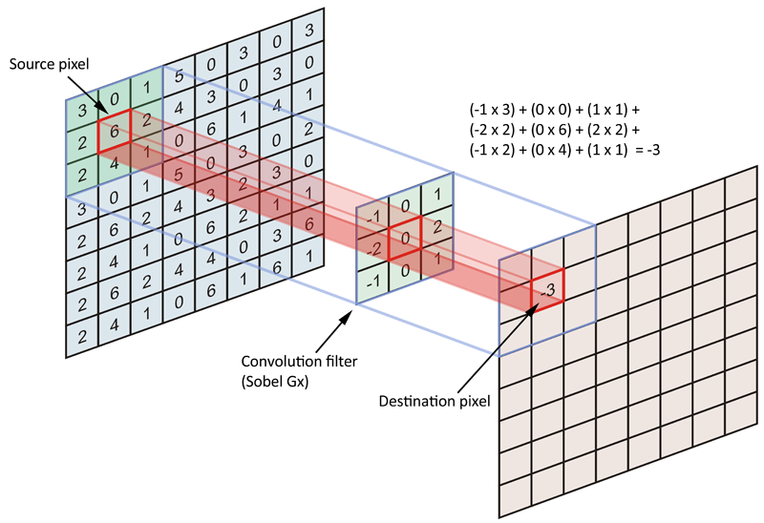

Slide 24
Smoothing Filters (low-pass)
Useful for reducing noise and eliminating small details.
  The elements of the mask must be positive.
  Mask elements sum to 1 (assuming normalization).
Noise is anything in the image that we are not interested in.
• Examples:
  – Light fluctuations
  – Sensor noise
  – Quantization effects
  – Finite precision

Slide 25
Mean (Averaging) Filter
Smoothing filters are used
  - Noise reduction
  - Smoothing of false contours
  - Reduction of irrelevant detail
Undesirable side effect of smoothing filters
- Blur edges
The elements of the mask must be positive.
The size of the mask determines the degree of smoothing.

Slide 26
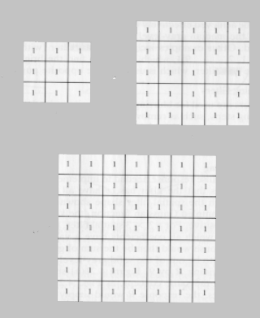

Slide 27
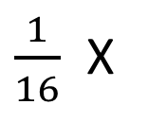
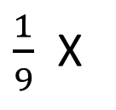
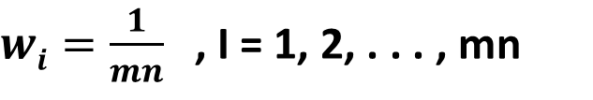
Consider the output pixel is positioned at the center
1
1
1
1
2
1
$\frac{1}{9}$ X
$\frac{1}{16}$ X
1
1
1
2
4
2
1
1
1
1
2
1
Since all weights are equal, it is called a BOX filter.
Weighted average give more(less) weight to pixels near (away from) the output location
$wi=\frac{1}{mn}$ , I = 1, 2, . . . , mn

Slide 28
Why Averaging Reduces Noise
Intuitive explanation: variance of noise in the average is smaller than variance of the pixel noise (assuming zero-mean Gaussian noise).
Sketch of more rigorous explanation:

Slide 29
Spatial filtering for Smoothing
For blurring/noise reduction;
Blurring is usually used in preprocessing steps,
e.g., to remove small details from an image prior to object extraction, or to bridge small gaps in lines or curves
Equivalent to Low-pass spatial filtering in frequency domain because smaller (high frequency) details are removed based on neighborhood averaging (averaging filters)

Slide 30
Implementation: The simplest form of the spatial filter for averaging is a square mask (assume m×m mask) with the same coefficients 1/m² to preserve the gray levels (averaging).
Applications: Reduce noise; smooth false contours
Side effect: Edge blurring

Slide 31

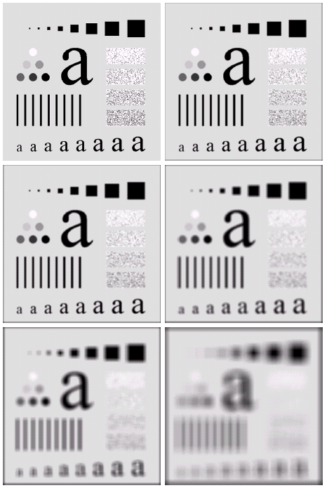


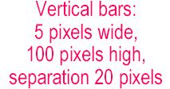

Spatial filtering for Smoothing (example)

Slide 32
Spatial filtering for Smoothing (example)
Original image size: 500 x 500
Smoothed by 3 x 3 box filter
Smoothed by 5 x 5 box filter
Smoothed by 9 x 9 box filter
Smoothed by 15 x 15 box filter
Smoothed by 35 x 35 box filter

Slide 33
Median filter (non-linear)
Effective for removing "salt and pepper" noise (random occurrences of black and white pixels).
Replace each pixel value by the median of the gray-levels in the neighborhood of the pixels

Slide 34
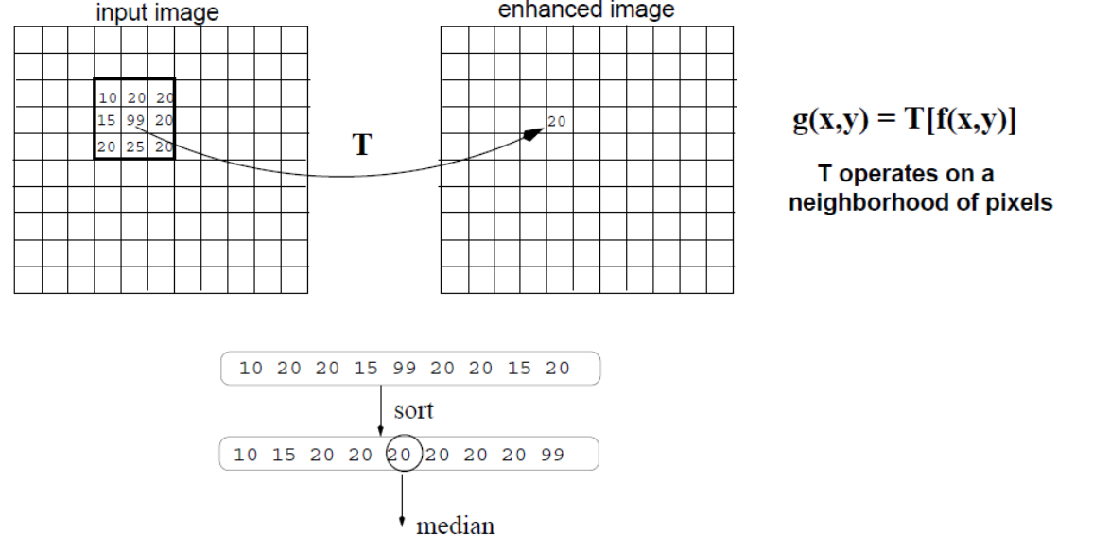

Slide 35
Sharpening (or High-pass)
It is used to emphasize the fine details of an image (has the opposite effect of smoothing).
Points of high contrast can be detected by computing intensity differences in local image regions.
The weights of the mask are both positive and negative.
When the mask is over an area of constant or slowly varying gray level, the result of convolution will be close to zero.
When gray level is varying rapidly within the neighborhood, the result of convolution will be a large number.
Typically, such points form the border between different objects or scene parts (i.e., sharpening is a precursor step to edge detection).

Slide 36
